Slide 1
SUBJECT:. FASHION DESIGNING
TOPIC : DESIGNING FOR USUAL AND UNSUAL
FIGURES
STAFF DISGNATION : R.KIRUBA
HEAD & ASSISTANT PROFESSOR IN CDF
DEPARTMENT

Slide 2
Deigning dresses for unusual figure
Few people are as perfect as to general figure, shape of the face, coloring, etc., that they are able to wear almost any type of dress and look well. Many of us have certain peculiarities such as narrow shoulders, flat chest or round shoulders, a large bust, or our face may be very square, so that we must use care in the design and selection of our dress.

Slide 3
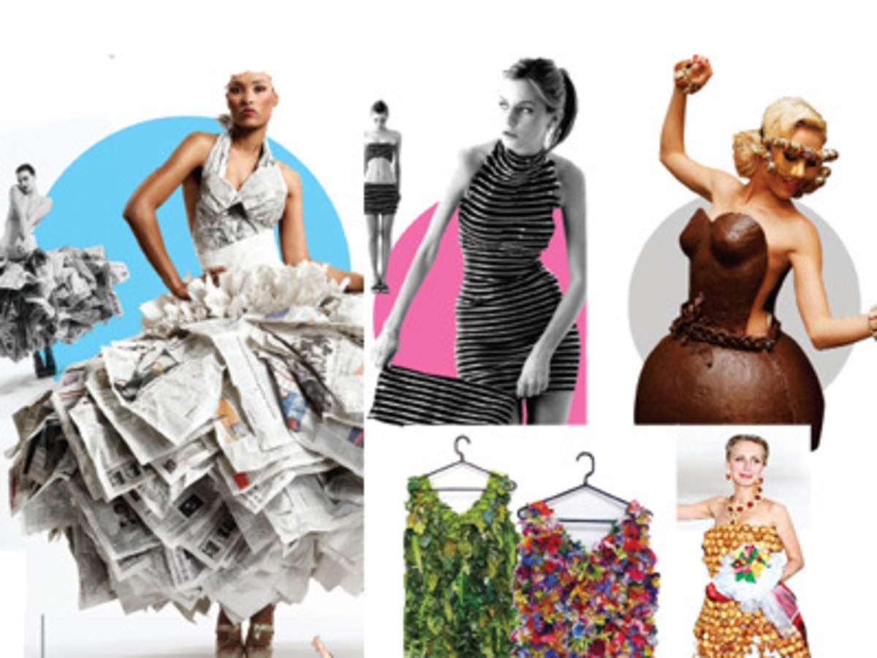
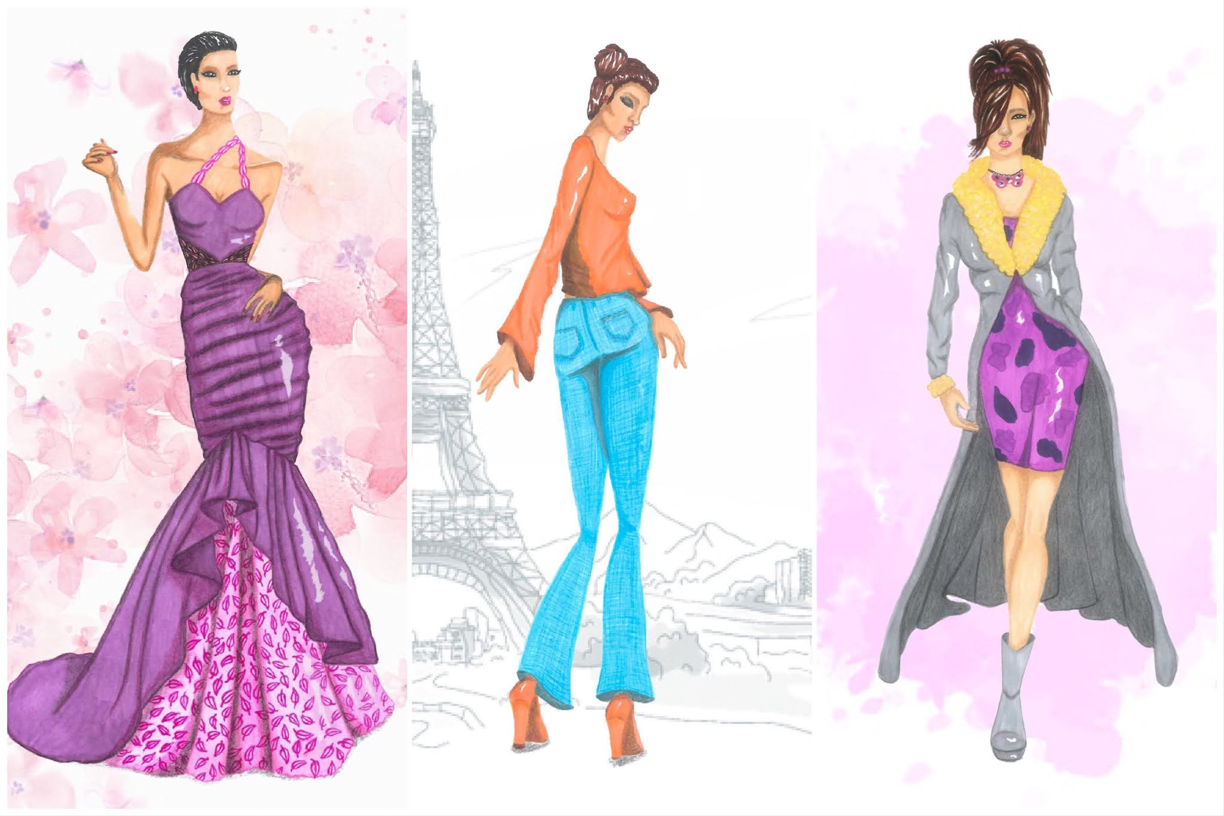
UNUSUAL FIGURES:-

Slide 4
The unusual figures are classified in to two groups.
Becoming
Unbecoming
BECOMING:
One material or color used thought the costume rather than breaking it up into separate parts
Soft yet not tight fabrics
Fabrics with dull surface
Dull colours in large areas

Slide 5
An unbroken silhouette if the figure is normal
Transitional lines in the dress rather than extreme curvesor angles.
Vertical movement in the lines of the dress.
Comparatively long skirts.
Skirt that flare a little in centre front with a straight silhouette.
A normal waist line or slightly above or below it
No belt or narrow belt.
Slim ,long set in sleeves

Slide 6
Simple neck lines ,preferably long lines and long collars.
Short jackets the same color as the skirt.
Long coats and jackets.
Dark furs.
Hats of moderate size,
Hats that suggest an upward (vertical lines) movement.
Hair dressed high.

Slide 7
unbecoming:
Lustrous fabrics taffetes and other stiff fabrics
Plaids or may large or outstanding surface pattern .
Heavy ,bulky fabrics
Fabrics that take round lines
Bright color in large lines.
Unnecessarily full long Garments
Very full or tight garments
Ruffles
Horizontal movements in the lines of the dress.

Slide 8
Very wide or extremely narrow panels.
Pleats ,panels or any trimming ending or starting ay a point where the figure is large .
Very narrow lines of trimming.
Thin piping.
Large circles on hats or dresses.
Short skirts.
Skirt which flare all around
Yokes on skirt Entire sleeves tight fitted.
Transparent sleeves.

Slide 9
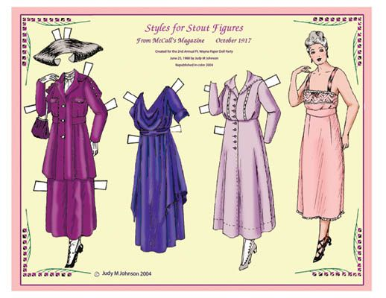
The Stout Figure

